Slide 1
College of Science &
Engineering Technology

Slide 2
College of
Science & Engineering Technology
School of Agricultural Sciences
Departments of
  Biological Sciences
  Chemistry
  Computer Science
  Engineering Technology
  Environmental and Geosciences
  Mathematics and Statistics
  Physics and Astronomy
Centers and Facilities
  STEM Center
  Cyber Forensic Intelligence Center
  Gibbs Ranch
  Dominey Observatory
  Pineywoods Experimental Research Laboratory (PERL)
  Natural History Collections

Slide 3
FY 2024 Accomplishments
Priority 1: Prioritize Student Success and Student Access
  Fall 2022 to Fall 2023 unduplicated headcount rose 3.3% and retention rose 4.5%.
  Mathematics and Statistics onboarded 10 visiting assistant professors, stabilizing mathematics and statistics gateway course instruction.
  Pass rates improved in BIOL 1408 (8%), CHEM 1411 (8%), CHEM 1412 (3%), and MATH 1410 (12%). New initiatives began in animal science and geology.
  COSET began offering several degrees and received approval for several more: BS Data Science, 4+1 BS/MS Computing and Data Science, 4+1 BS/MS Mathematics, MS Business Security and Resilience, BS Biochemistry.
  COSET self-funded continuation of the STEM Center, which offered programming like Catapult into STEM Summer Bridge Course.
  Biological Sciences began an MOU with the Texas Autism Academy and collaborated with COHS and Services for Students with Disabilities to start AutismWorks.
  COSET began exploring MOUs with several international universities.
Notes:
Minors: Astronomy, Advanced Chemistry, Crime Analysis and Mapping
Certificate: Crime Analysis and Mapping, Computing and Data Science
Concentrations: Biochemistry and Medicine, Forensic Science, Biomedical Engineering Technology, Animal Care and Welfare, Ranch Management
OSHA certification for Quanta Services

Slide 4
FY 2024 Accomplishments
Priority 2: Embody a Culture of Excellence
  COSET faculty and staff submitted $46.6 million in external proposals and secured $6.7 million in grant funding in FY23.
  Computer Science and Engineering Technology initiated new accreditation applications with ATMAE and ABET. Engineering Technology hosted a successful ATMAE site visit.
  COSET began the MOU process with U.S. Census Bureau and an Educational Partnership Agreement with the National Security Agency.
  COSET, COM, and COHS collaborated through the Colleagues & Collaboration seminar.
  In partnership with COHS and COM, faculty from Biological Sciences and Chemistry began enrichment programs for biomedical students and secured NIH funding.
  The Natural History Collections acquired several significant collections.

Slide 5
FY 2024 Accomplishments
Priority 3: Elevate the Reputation and Visibility of SHSU
  SHSU and Agricultural Sciences completed Gibbs Ranch Phase I expansion and hosted the inaugural rodeo to a sold-out crowd.
  SHSU and Physics & Astronomy completed Dominey Observatory Phase I expansion, offering the only ADA compliant observatory of its kind.
  COSET co-sponsored the Texas A&M University Mitchell Institute Collider, Dark Matter, and Neutrino Physics Workshop; and Physics & Astronomy partnered with Kavli Institute of Theoretical Physics.
  Summer Camps: Engineering Technology began offering the Bearkat STEM Camp. Environmental and Geosciences hosted the Geoscience Exposure and Training in Texas (GET TX) summer camp.

Slide 6
FY 2024 Accomplishments
Priority 4: Expand and Elevate our Service to the State and Beyond
  COSET faculty offered 29 ACE courses, impacting 771 students and providing $858k in economic impact.
  Engineering Technology faculty and students, in partnership with Entergy, completed a solar EV fast-charging station.
  The Cyber Forensics Intelligence Center and IT@Sam developed plans for a Security Operations Center, which will be functional soon.
  Environmental and Geosciences hosted ~100 Conroe Academy students to discuss career opportunities in the Geosciences and engaged with area students and teachers through the grant-funded project “Building an Engaging Place-Based Geography Learning Community in Metro Houston.”
  The School of Agriculture hosted career and leadership development events for the FFA and 4H, serving over 3000 youth.

Slide 7
FY 2025 Keep Doing
Statement: COSET plans to keep supporting the STEM Center because the strategic plan and Keep, Stop, Start comments confirm a need for it. This action aligns with Strategic Priority 1: Prioritize student success and student access, Goal 1.1: Recruit, retain, and empower students to drive sustainable growth and will have a positive impact on undergraduate STEM student professional development in achieving Pillar 2 - Retention.
Supporting Data: The COSET strategic plan relies heavily on the STEM Center to support Strategic Priority 1: Student success and student access. Seventy percent of the COSET Keep, Stop, Start survey “Keep” replies referred to the STEM Center.
Resources / Collaborations Required: -COSET funding for programming and administrative support -Interdisciplinary efforts across COSET and with academic support offices -Collaboration with University Advancement and ORSP to secure long-term funding

Slide 8
FY 2025 Keep Doing
Statement: COSET plans to keep funding college-level marketing support because increased efforts at outreach are vital to the strategic plan without creating additional workload for faculty and staff. This action aligns with Strategic Priority 3: Elevate the reputation and visibility of SHSU, Goal 3.4: Identify/improve, promulgate, and leverage the SHSU brand and will have a positive impact on outreach to future students and external partners in achieving Pillar 1 - Enrollment.
Supporting Data: A full-time staff position was recommended/requested by Integrated Marketing Communications (IMC), COSET departments, and Dean’s Office staff. A half-time position was self-funded, beginning January 2024, and has demonstrated ROI to-date.
Resources / Collaborations Required: -Funding for a half-time staff position -Collaboration with IMC, COSET Dean’s Office, and COSET departments

Slide 9
FY 2025 Stop Doing
Statement: COSET plans to stop offering face-to-face dual enrollment courses at Blinn College because the piloted model produced low enrollment. This action aligns with Strategic Priority 1: Prioritize student success and student access, Goal 1.1: Recruit, retain, and empower students to drive sustainable growth and will allow COSET to refocus transfer recruitment efforts in achieving Pillar 1 - Enrollment.
Supporting Data: The courses generated low dual enrollment during 2023 – 2024 academic year. The partnership remains intact, but we are exploring a different model. A second partnership has begun with Houston Community College, with grant funding support from USDA and informed by the Blinn College experience.
Resources / Collaborations Recovered: -Salary, travel, and supplies -Collaborations with Strategic Enrollment & Innovation, Blinn College, and Houston Community College

Slide 10
FY 2025 Stop Doing
Statement: COSET plans to stop offering the MS Geographic Information Systems - Professional Track because Environmental & Geosciences does not have the resource capacity to offer both a traditional track and a fully online track, while expanding interdisciplinary undergraduate offerings. This action aligns with Strategic Priority 2: Embody a culture of excellence, Goal 2.1: Academic excellence and will have a positive impact on curriculum development in achieving Pillar 1 – Enrollment and Pillar 4 – Agility.
Supporting Data: The part-time students in this track represent ~1/3 of the MS GIS headcount but require that courses be offered online or that section offerings be duplicated for the traditional track. Demand for interdisciplinary undergraduate programs and associated course offerings has grown, offering potential for enrollment growth at the undergraduate level if resources are allocated judiciously.
Resources / Collaborations Recovered: -Faculty course load and graduate scholarships -External partnerships and College of Criminal Justice

Slide 11
FY 2025 Stop Doing
Statement: COSET plans to stop offering bonus scholarships to students with graduate assistantships because they had limited enrollment impact and increased workload for graduate advisors and office staff. This action aligns with Strategic Priority 1: Student success and student access, Goal 1.1: Recruit, retain, and empower students to drive sustainable growth and will have a positive impact on COSET graduate enrollment in achieving Pillar 1 - Enrollment.
Supporting Data: Twenty-five percent of Keep, Stop, Start survey “Stop” responses identified this action. It was supported by the majority of COSET graduate advisors and Dean’s Office staff.
Resources / Collaborations Recovered: -Recruitment scholarships for online students and out-of-state students without assistantships -Workload associated with awarding the bonus scholarships -COSET graduate advisors, COSET Dean’s Office staff, The Graduate and Professional School

Slide 12
FY 2025 Start Doing
Statement: COSET plans to start a Security Operations Center (SOC) in partnership with IT@Sam because it is a cost-effective way to provide cyber security to SHSU, support students, and eventually serve external partners. This action aligns with Strategic Priority 3: Elevate the reputation and visibility of SHSU, Goal 3.3: Strengthen relationships with the greater SHSU community. It will leverage the national reputation of our cyber security program to increase student credentialing opportunities and serve both SHSU and external partners in achieving Pillar 4 – Agility.
Supporting Data: Computer Science is designated a Center of Academic Excellence in Cyber Defense Education by the National Security Agency and the Department of Homeland Security and houses the CFIC. Alumni, advisory board members, and public officials have volunteered to help the CFIC develop the SOC and secure state and federal funding to expand service to entities in our region.
Resources / Collaborations Required: -Student wages and funding for training -IT@Sam, local cities, law enforcement, school districts, state and federal partners

Slide 13
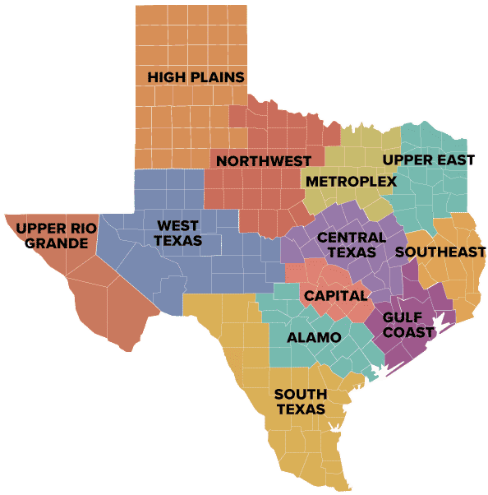

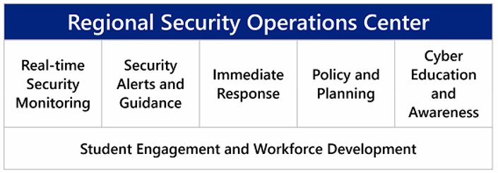
Regional Security Operations Center (RSOC)
Entities eligible for RSOC services include:
Cities and Counties
Independent School Districts
Special Districts
Independent Organizations
State Agencies
Public Junior Colleges
SHSU Benefits
  Workforce development: train cybersecurity students
  Serve the community: Energy infrastructure, law enforcement, local and regional agencies, schools, etc.

Slide 14
College of
Science & Engineering Technology
KEEP DOING
  Keep #1: STEM Center
  Keep #2: Marketing Specialist
STOP DOING
  Stop #1: Blinn College Dual Enrollment On-Site Courses
  Stop #2: MS GIS – Professional Track
  Stop #3: Graduate Student Bonus Scholarships
START DOING
  Start #1: Security Operations Center

Slide 15
Questions?

